Slide 1



Towards Adaptive and Scalable Hierarchical Federated Learning
University of Naples “Parthenope”,
Dept. of Science and Technology,
M.Sc. Machine Learning & Big Data
Cloud Computing Seminar (A.Y. 2024/2025)
Author: Marco Lettiero (ID: 120/286)

Slide 2
Outlines
Federated Learning overview
Federated Learning
Hierarchical Federated Learning
Convolutional Neural Network overview
Problem statement
The Proposed Method
Experimental Setup and Results
Comparisons
Conclusions and Future Works

Slide 3
Federated Learning
Federated Learning (FL) is a collaborative approach for machine learning.
Client devices (e.g., edge devices) train local models with local data.
A central node is used to aggregate the partial results.

Slide 4
Federated Learning
FL ensures the statistical heterogeneity of client datasets and fairness.
It avoids data exchange guaranteeing privacy and compliance to regulations for PII data.
It is a robust approach as it avoids the single point of failure.

Slide 5

Federated Learning
Let $K$ be the number of clients where each client $k$ has a dataset $D_{k}$.
The local model parameters $w_{k}$ are optimized with the objective function:
$$\min_{w_{k}}{ℒ_{k}\left(w_{k}\right)= \frac{1}{|D_{k}|}\sum_{\left(x,y\right)∈D_{k}}{ℒ(f\left(x;w_{k}\right),y)}}$$
Local models are aggregated in the central node, e.g., FedAvg:
$$w= \frac{1}{K}\sum_{k=1}^{K}{w_{k}}$$
Notes:
f is the prediction of the model given the input x and parameters w_k

Slide 6
Hierarchical Federated Learning
FL suffers of communication overhead in large-scale deployments.
Scalability can be affected by unreliable connectivity.
Hierarchical Federated Learning (HFL) addresses these limitations.

Slide 7
Hierarchical Federated Learning
An intermediate layer of edge servers is added.
Clients perform a local federated training session with a given edge server.
The central node aggregates the local models from the intermediate layer.

Slide 8

Hierarchical Federated Learning
Each edge server $e$ aggregates the local models of its assigned clients $𝒞_{e}$:
$$w_{e}= \frac{1}{|𝒞_{e}|}\sum_{k∈𝒞_{e}}{w_{k}}$$
Equivalently, the central server aggregates the intermediate edge models:
$$w= \frac{1}{E} \sum_{e=1}^{E}{w_{e}}$$
Notes:
Assuming to use FedAvg as before…
E is the total number of edge servers

Slide 9
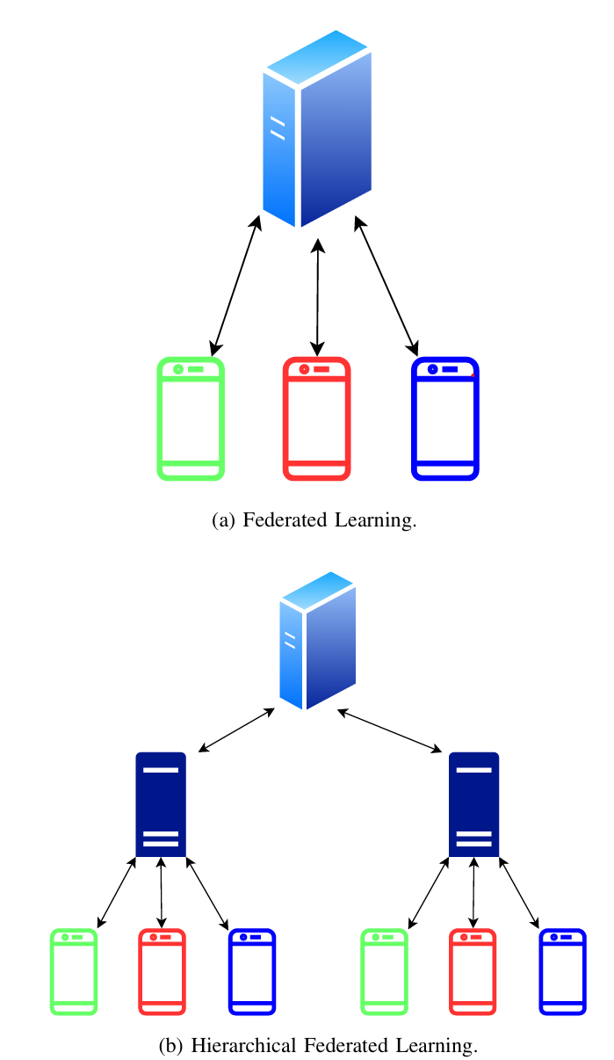
Hierarchical Federated Learning
State-Of-The-Art (SOTA) approaches are based on a fixed number of edge servers.
Three-layers architectures are the most common, yet effective.

Slide 10
Convolutional Neural Network (CNN)
CNNs are deep learning architectures designed for processing visual data by learning spatial hierarchies of features.
They are characterized by the presence of
Convolutional layers
Non-linear activation functions
Pooling layers
Fully connected layers
Notes:
Training a CNN can be quite demanding, so it can highly benefit of a FL based approach.

Slide 11
Problem statement
A fixed set of edge servers risk resource underutilization.
Static resources may be overwhelmed during peak workloads.
Static placement fails to align with evolving spatial distributions of clients.

Slide 12
Problem statement
Recent studies propose orchestrators and virtualization tools.
They still rely on fixed/pre-provisioned set of edge servers.
Kubernetes/Docker constitutes the SOTA approach.

Slide 13
The proposed method
A dynamic auto-scaling mechanism to address these limitations.
The deployment depends on the current system conditions.
An edge server is allocated “on demand”.

Slide 14
The proposed method
The system manages communication overhead and adapts according to it.
This system includes clients, edge servers, and a central node.
It does not rely on external orchestrator.

Slide 15
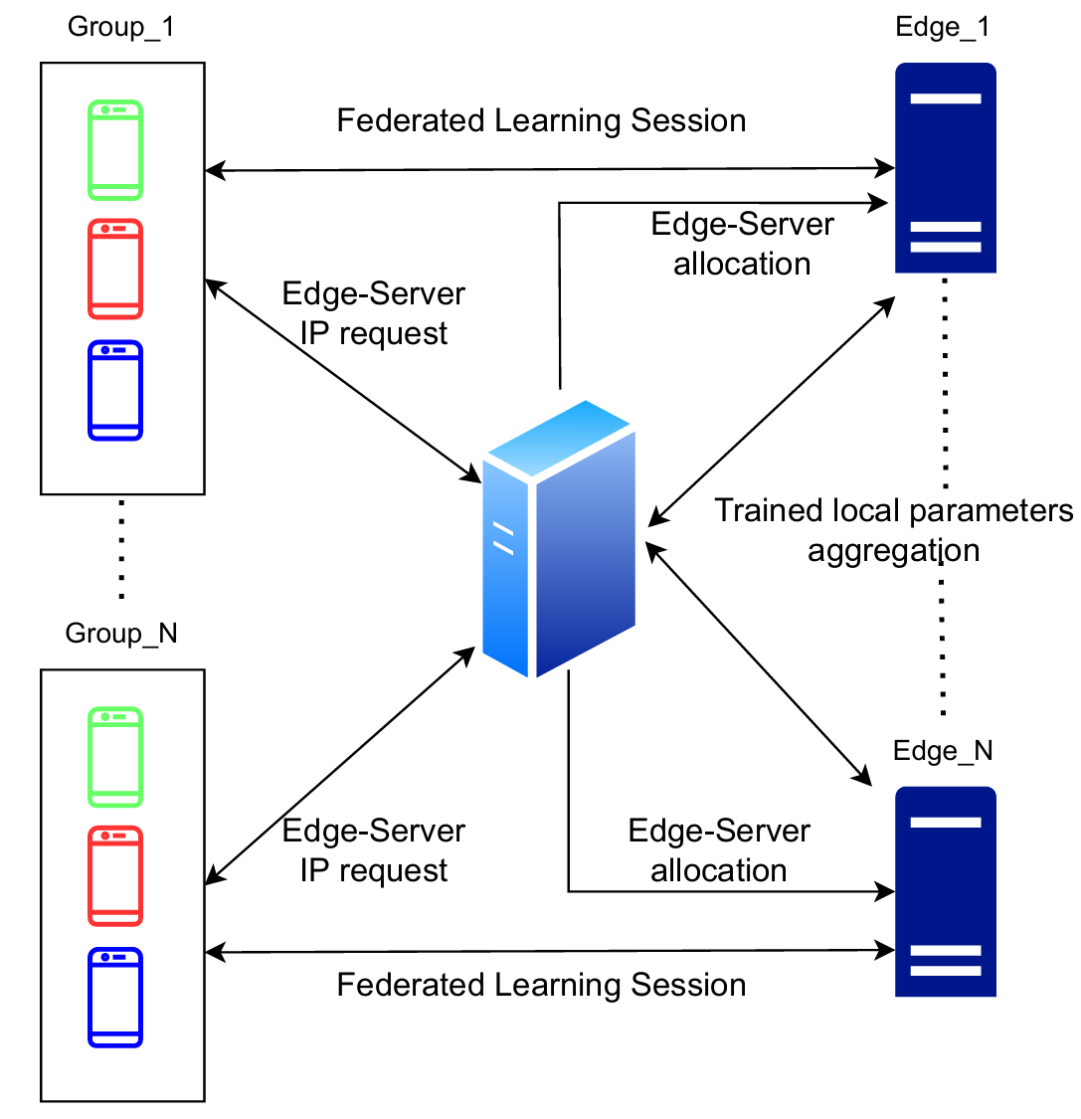
The proposed method
Edge servers are allocated according to client requests.
Edge servers become clients for the central node once the intermediate session is concluded.
The central node aggregates the local models.
Notes:
The image on the right illustrates the schema of our configurations where edge servers are allocated on demand. Once intermediate federated sessions have been concluded, they behave as clients for the central node. Here, only an aggregation is performed.

Slide 16
The proposed method
The proposed method allows for any allocation schema (e.g., Azure VMSS).
Only simulated on a local machine (Docker).
Azure for Students imposes quota limits.

Slide 17
Experimental Setup
TinyVGG has been trained on each client.
Training is performed using only few CPU cores.
A small fraction of Fashion-MNIST dataset is sampled for each client (simulates IID data)

Slide 18
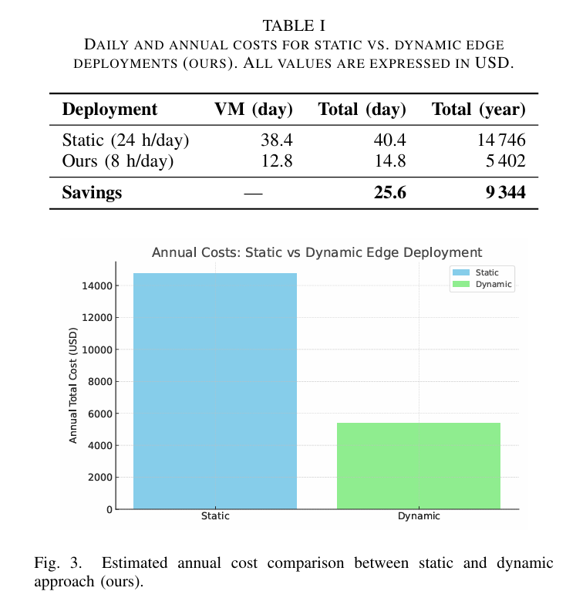
Experimental Results
The dynamic approach can lead to huge savings over long time windows.
Cost estimations are based on Azure pricing for Virtual Machines (VMs), public IP addresses and storage.

Slide 19
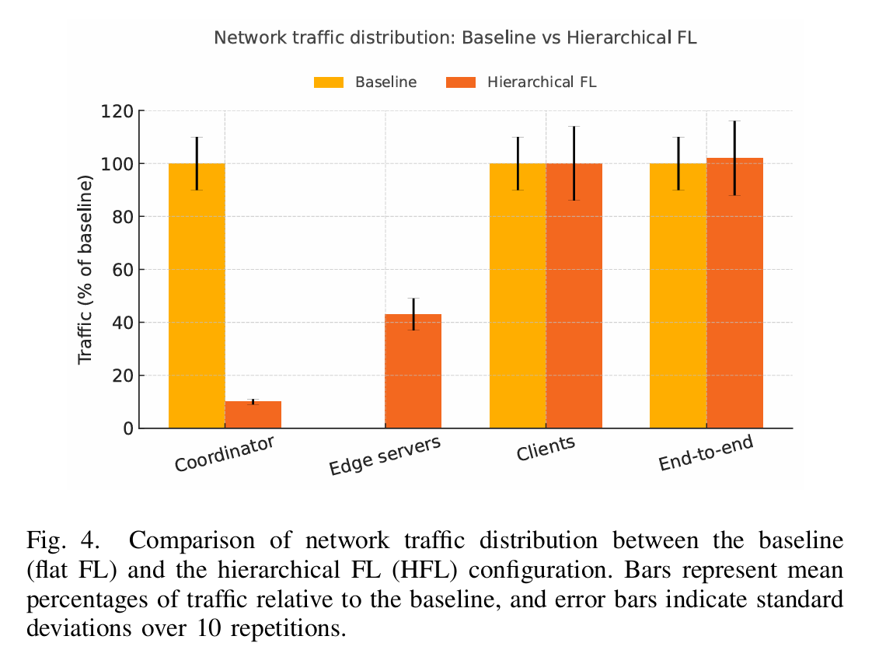
Experimental Results
Communication overhead is on edge servers.
Added overhead is negligible.
Not always true (DNS, CDN hops).

Slide 20
Comparisons
This approach favours short-lived, geographically sparse workloads.
Moving to other solutions is not straightforward.
W.r.t. other approaches (e.g., Kubernetes), VMs allocations in cloud can be slow (i.e., 2~3m).
Notes:
If the number of VMs increases too much and/or they remain active for too much time, other solutions begin to overcome the proposed method.

Slide 21
Conclusions and Future Works
The auto-scaled HFL framework has been proved to reduce annual costs.
Future works can extend the proposed method with multi-tier topologies.
This work contributes with an open-source lightweight orchestration mechanism.
Notes:
And, of course, it remains to prove that in a real cloud computing environment this solution still works.

